Slide 1
The CARDEA project is funded by the European Union. Views and opinions expressed are however those of the author(s) only and do not necessarily reflect those of the European Union or the European Research Executive Agency (REA). Neither the European Union nor REA can be held responsible for them.

Slide 11
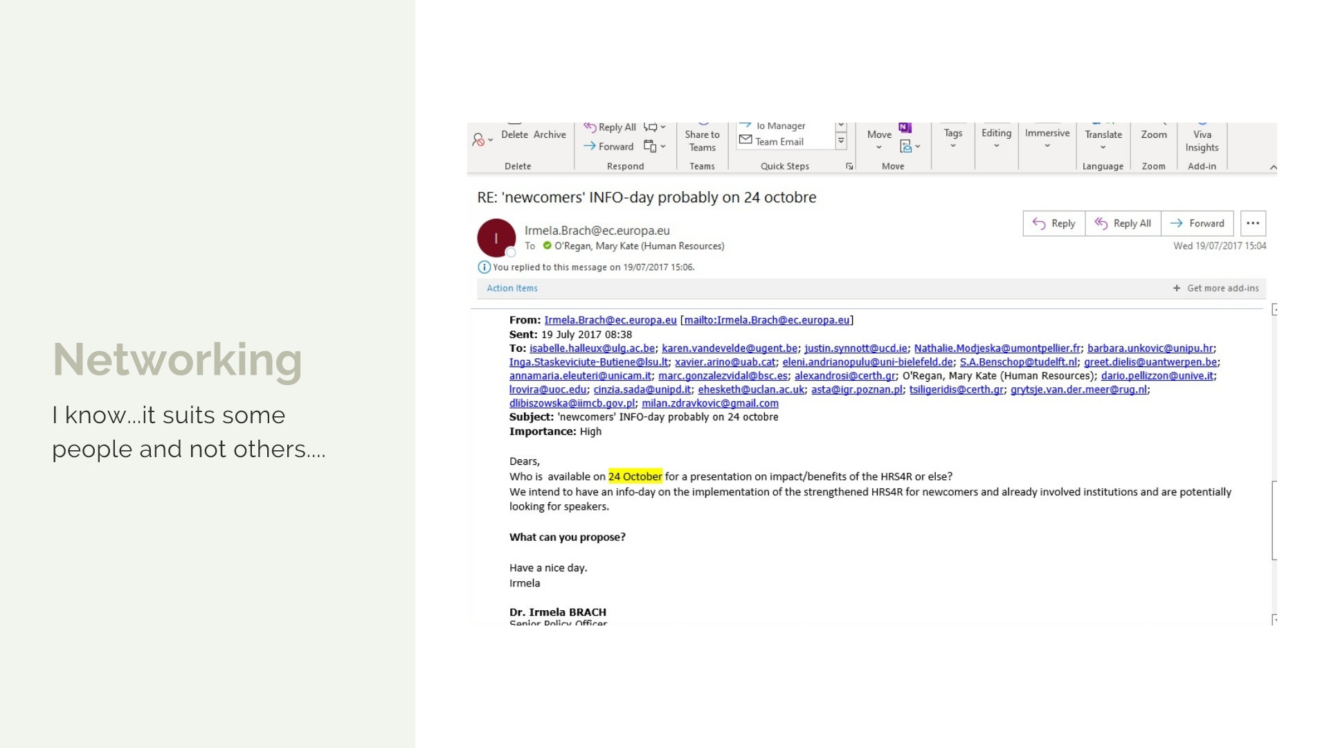

Slide 23
CARDEA
Ancient Roman Goddess of the Hinge
Research Managers open Research Doors

Slide 24
What it stands for
Career Acknowledgement for Research Managers Delivering for the European Area

Slide 26
Proven Track Record
HR Excellence in Research
EURAXESS

Slide 27
Synergy

Slide 28
The Challenge
Research Manager roles are invisible
Policy, Career Development, Progression
No consistency in salary, skills, competencies and training across the ERA
CARDEA

Slide 29
Priority deliverables
Research Manager as a valued career choice
Classification of Research Manager Roles
Knowledge, Skills, Competencies required
Training and Development
Knowledge Hub
Policy, lobbying and engagement with stakeholders
CARDEA

Slide 30
Initial Survey Results from 36 participating countries (n = 528)
75% of Research Managers are Female, average age 44 years;
92% have a Masters of PhD level qualification;
68% indicated that their title (as per contract) did not agree with the job as they deliver it;
90% feel they understand how their role fits within the organisation;
54% of indicated that the role of the Research Manager was not defined at the national level;
68% of Research Managers in ERA are funded through core institutional funding;
23% linked to individual grants (9% do not know how their position is supported);
21% indicated that there are career progression opportunities in their role;
49% see their long-term role in Research Management, with 40% unsure;
54% have access to a professional development plan.

Slide 31
Initial Survey Results from 36 participating countries
75% of Research Managers are Female, average age 44 years;
92% have a Masters of PhD level qualification;
68% indicated that their title (as per contract) did not agree with the job as they deliver it;
90% feel they understand how their role fits within the organisation;
54% of indicated that the role of the Research Manager was not defined at the national level;
21% indicated that there are career progression opportunities in their role;

Slide 32
How does this help Research Managers?

Slide 33
The Odyssey Programme Assisting Researchers to move Beyond Academia
“Had I not taken part in your programme, I don’t think I ever would have had the confidence (or the know-how) to apply for my current role. I am currently working with (company name omitted) as a Senior Engineer, Biomedical Engineering and have been super happy here for the past 10 months. I look forward to what the future holds for me..“
Participant Feedback

Slide 34
CARDEA
Every new beginning comes from other beginnings end
Seneca the Elder

Slide 35
CARDEA – ARMA – THANK YOU
TODAY IS A GOOD DAY FOR RESEARCH MANAGERS!

